Slide 1
FUTURE ROCKSTARS
Rajvinder Singh
Kailash Naik
Sai Teja Vallabhaneni
Pratik Chakraborty
IST303 – Software Development - https://github.com/singhraj82/FURS

Slide 2
MILESTONE 2.0
Sprint 4 – 24th Oct.
Sprint Planning
Sprint 2 – 20th Nov.
Design and Development
Implement check-in process – Assign Dorms by Gender/Age – Assign Ranks – Automate band Assignment – Waitlist Creation
Sprint 3 – 1st Dec.
Testing and Release
Final Testing – Project Final Release
Band Assignment Product Backlog Milestone Setup
Dorm Assignment Product Backlog Milestone Setup

Slide 3
VELOCITY
Milestone - 2
Sprint 3 – 20 Units
Sprint 4 – 10 Units
Sprint 5 – 2 Units
Average Velocity – 10.66
Milestone - 1
Sprint 1 – 20 Units
Sprint 2 – 15 Days
Average Velocity – 17.5

Slide 4
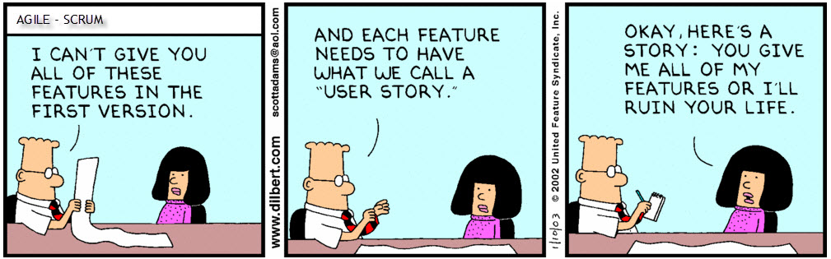
USER STORIES
Dates: 3 Options
Registration: Clerk to enter details
Data Retrieve: Access stored applications
Data Storage: Offline mode /Local Memory
Status: Accept/Reject/ Waitlist
Check-In
Band Assignment
Dorm Assignment
Decision Letter Automation
Image Credits: www.dilbert.com

Slide 5
Requirement Gathering and Planning Poker
Backlogs SPRINT CYCLE
User Stories 1
Design Architecture 1
Technology Grasp 1
Pilot Model Implementation 1
Pilot Model Testing 1
Design and Development of Database 2
Connect Application to Database 2
UI/UX Enhancement 2
Product Testing 2
Testing Automation 3
Implement Check-In process 3
Dorm Assignment 3
Band Assignment 4
Secondary Band Assignment 4
Waitlist Management 4
Final Testing 5
Product Delivery 5

Slide 6


Planning Poker
Testing Automation (S-3) 7
Implement Check-In process (S-3) 7
Dorm Assignment (S-3) 6
Band Assignment (S-4) 4
Secondary Band Assignment (S-4) 3
Waitlist Management (S-4) 3
Final Testing (S-5) 2

Slide 7
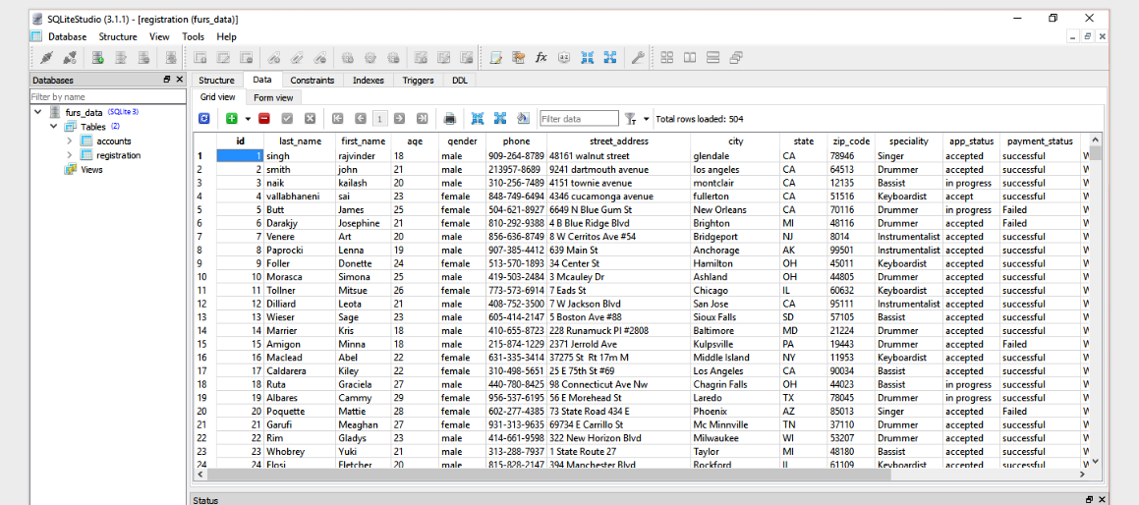
Database Structure and Design
Reasons:
Lightweight
Executes queries in-memory (RAM)
Enabling Faster Transaction
Good for small scale application
Familiar with SQL language
Other Available Options:
Stream read and write: Inefficient Parsing
MySQL: Heavy due to extra inclusive features, unnecessary for this application

Slide 8
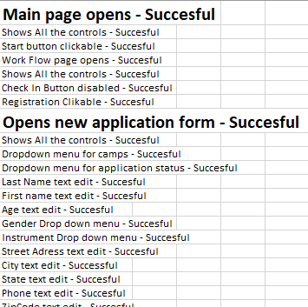
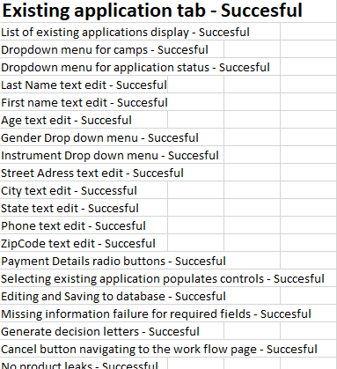
Manual Test Reports

Slide 9
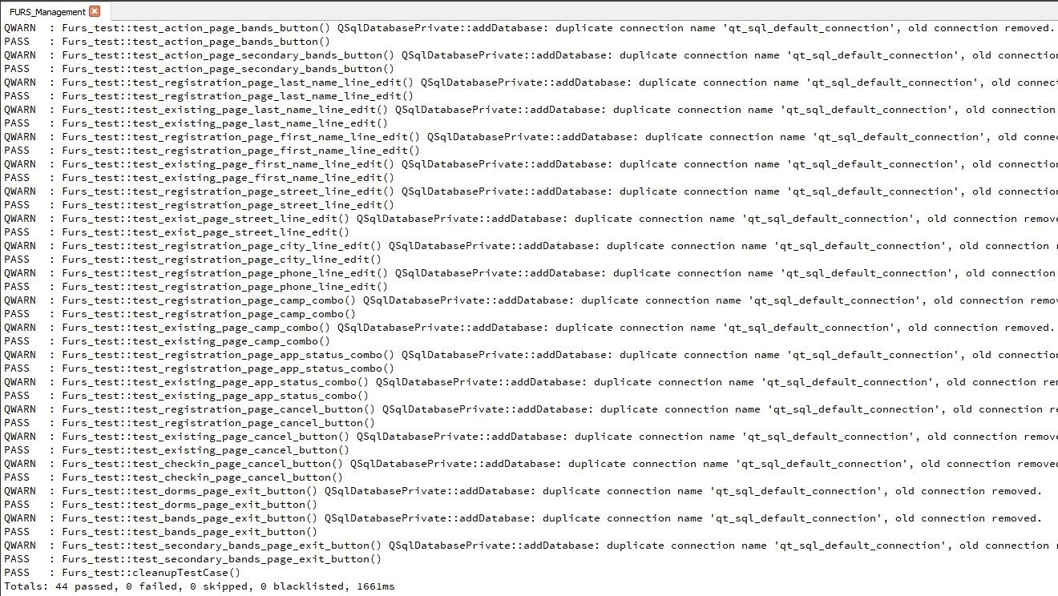
Automated Test Reports
Tool - Qt Testing Framework
Unit Tests
UI Tests

Slide 10



TECHNOLOGY
Used in development, C++ serves as a low-level language providing a faster and better performance.
Qt is a C++ based cross-platform framework providing all the features like GUI, Database connectivity and library accumulation.
SQLite is an in-memory database. As it is deployed locally, it enhances the performance and addresses the security and connectivity issues.

Slide 11

Automation And Implementation

Slide 12
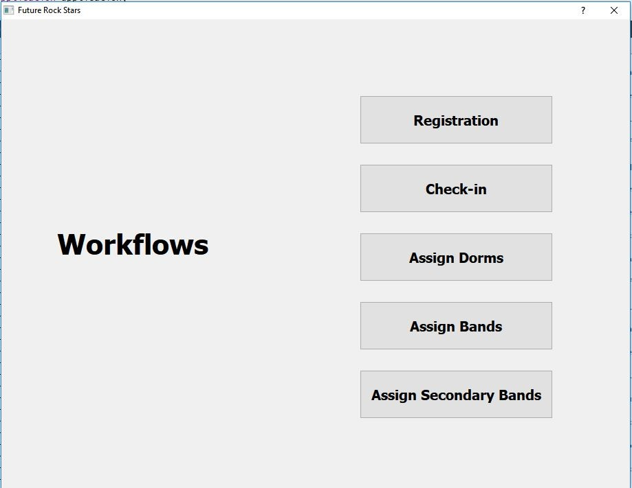
This is how it looks…

Slide 13
References
http://doc.qt.io/qt-5/index.html
http://www.sqlitetutorial.net/sqlite-insert/
https://sqlite.org/download.html
https://github.com/
Source code:
https://github.com/singhraj82/FURS
Text Book: Software Development by Dan Pilone & Russ Miles
Abrahamsson_et_al 2002

Slide 14


